Slide 1
Road Accident Data Analysis – India 2020
Identifying key causes, patterns, and preventive measures using Tableau
Shreya Singh Chauhan | Unified Mentor| 10 August
Project Link:- Tableau Dashboard

Slide 2
Understanding the Problem
Road accidents are a major public safety concern in India.
They result in loss of life, injuries, and economic impact.
In 2020, despite reduced traffic due to lockdowns, significant accidents occurred.
The aim is to analyze causes, locations, and patterns to aid in prevention.

Slide 3
Project Objectives
Identify major causes of road accidents.
Analyze accident trends across categories (weather, road features, junctions, etc.).
Use Tableau Dashboard to visualize and interpret the data.
Suggest preventive measures based on findings.

Slide 4
Dataset Description
Dataset Name: Regulatory Affairs of Road Accident Data 2020 India
Contains: Cause category & subcategory, City, Outcome of incident, Count of accidents
Data type: CSV file
Size: Few hundred records

Slide 5
Techniques Used – Data Cleaning
Removed irrelevant columns.
Ensured correct data types (text, numbers).
Checked for and handled missing values.
Standardized category names.
Grouped related cause categories for better visualization.

Slide 6
Techniques Used – Analysis & Challenges
Used Tableau for interactive dashboard creation.
Applied filters for city-wise and cause-wise insights.
Used multiple chart types (bar, bubble, pie, map).
Challenges: Limited data for some cities, overlapping category meanings, clarity in visualization.

Slide 7
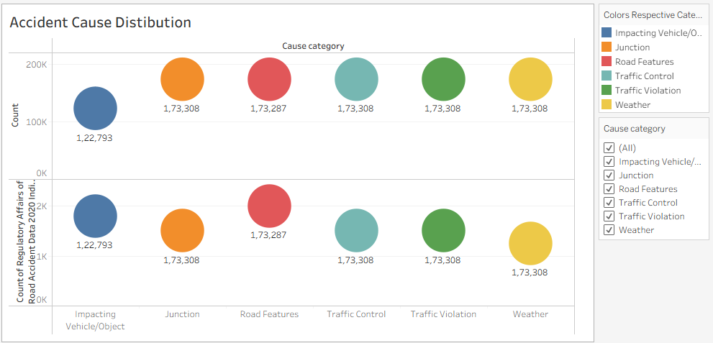
Accident Cause Distribution

Slide 8
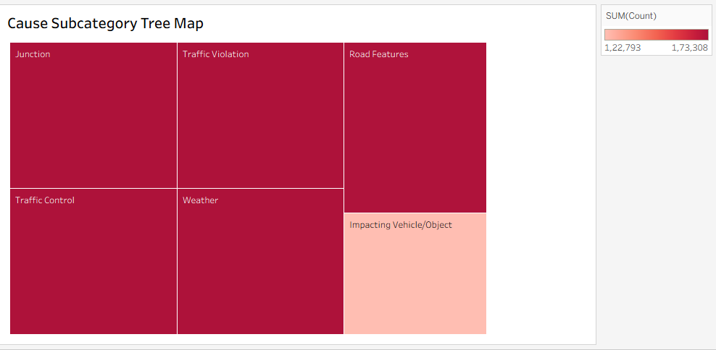
Cause Subcategory Tree Map

Slide 9
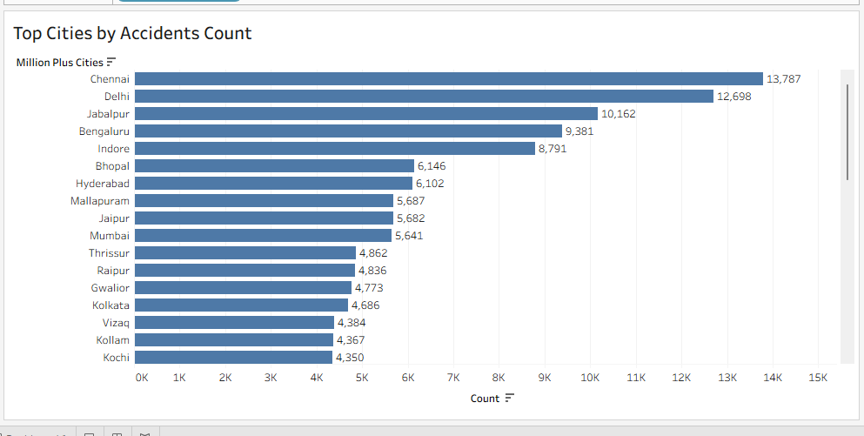
City-wise Accident Trends

Slide 10
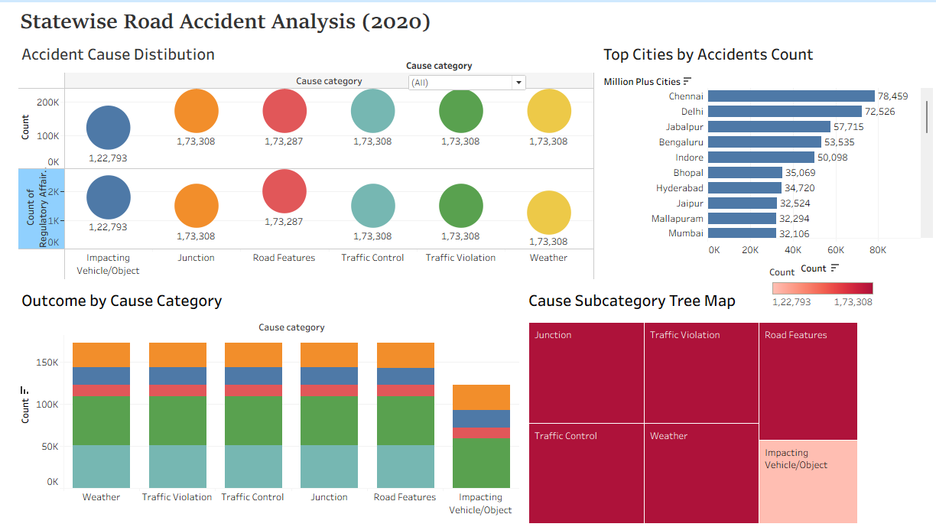
Final Dashboard Output

Slide 11
Key Findings & Recommendations
Most accidents occur due to road features, junction issues, and traffic violations.
Weather-related accidents are fewer but significant.
Recommendations: Improve traffic signal management, road safety awareness programs, better road infrastructure.

Slide 12
Data Science Job Salaries
Providing insights into salary trends across different countries, experience levels, and employment types using Tableau
Shreya Singh Chauhan | Unified Mentor | 10 August

Slide 13
Understanding The Problem
The Data Science industry is booming, but salaries vary greatly by role, region, and experience.
Lack of clear, consolidated salary benchmarks causes uncertainty for job seekers and employers.
Goal: Analyze global salary trends to identify key factors influencing pay.
Outcome: Provide insights to help professionals and organizations make informed decisions.

Slide 14
Project Objectives
To explore and visualize global Data Science salary trends.
Identify the impact of factors like country, experience, job title, and employment type on pay.
Deliver actionable insights for career planning and hiring strategies.

Slide 15
Dataset Descriptions
Source: Public dataset on Data Science job salaries from various global job postings.
Rows: 607 job records.
Purpose: Used to identify and analyze salary trends in the Data Science field.
Columns: 11 features including:

Slide 16
Techniques – Data Preparation and Data Cleaning in Tableau
Data Cleaning
Removed missing and duplicate records.
Standardized country codes to full names for readability.
Converted salary to consistent currency (USD).
Data Preparation
Created calculated fields (e.g., Salary in USD).
Grouped job titles into broader categories for analysis.
Encoded categorical variables for comparison.

Slide 17
Techniques Used- Data Visualization
Data Visualization
Used Tableau for interactive dashboards.
Bar charts, maps, and scatter plots for trend analysis.
Filters for year, job title, and experience level.

Slide 18
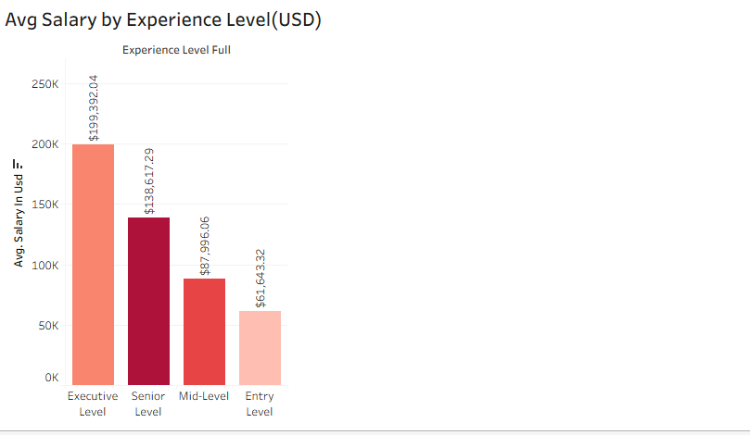
Average Salary by Experience Level(USD)

Slide 19
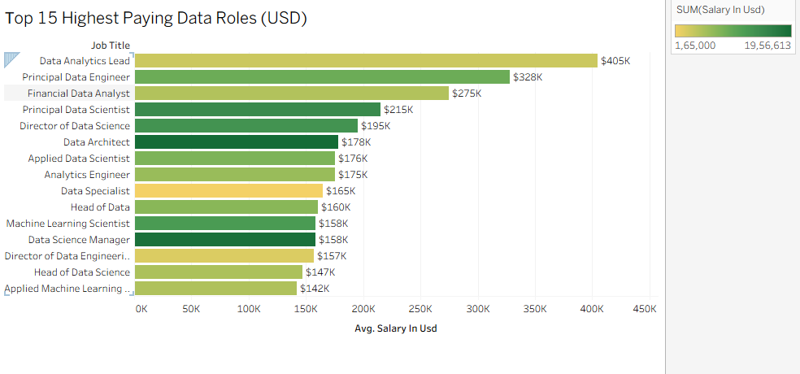
Top 15 Highest Paying Job Titles

Slide 20
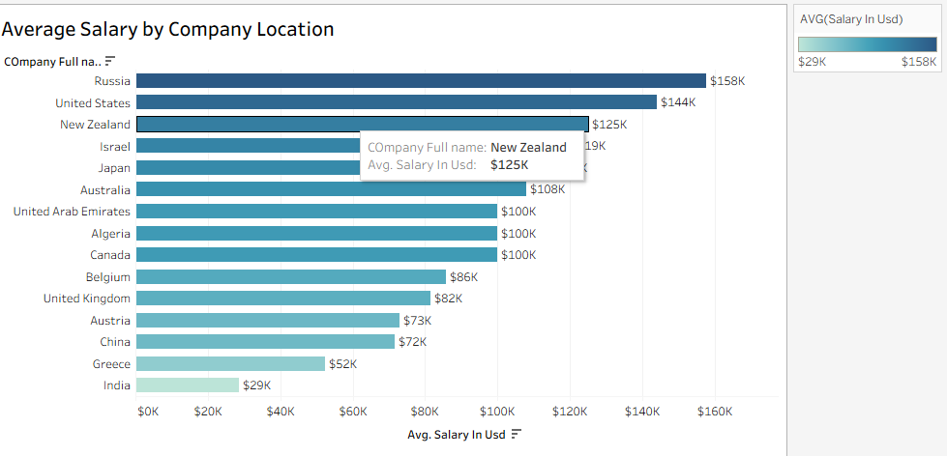
Average Salary by Company Location

Slide 21
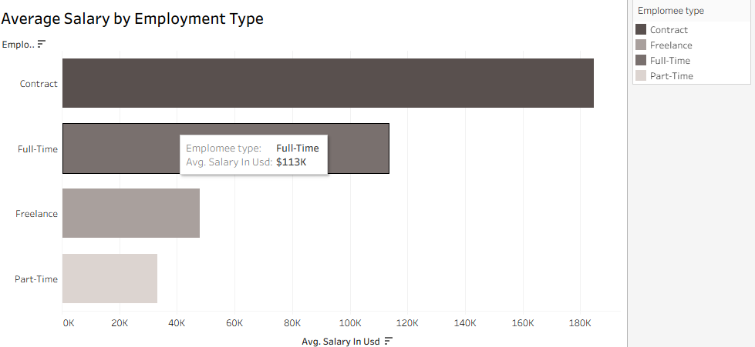
Average Salary by Employment Type

Slide 22
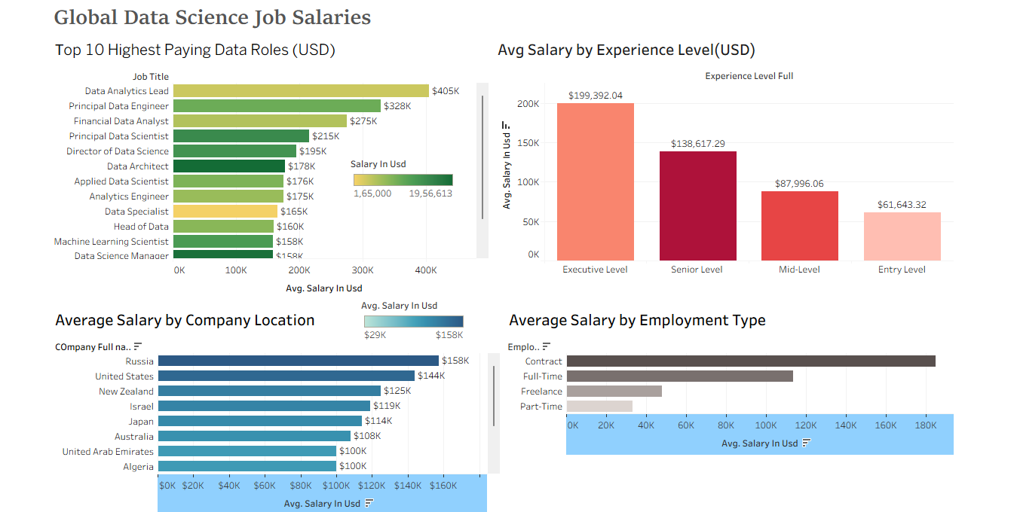
Final Dashboard Output

